Slide 1
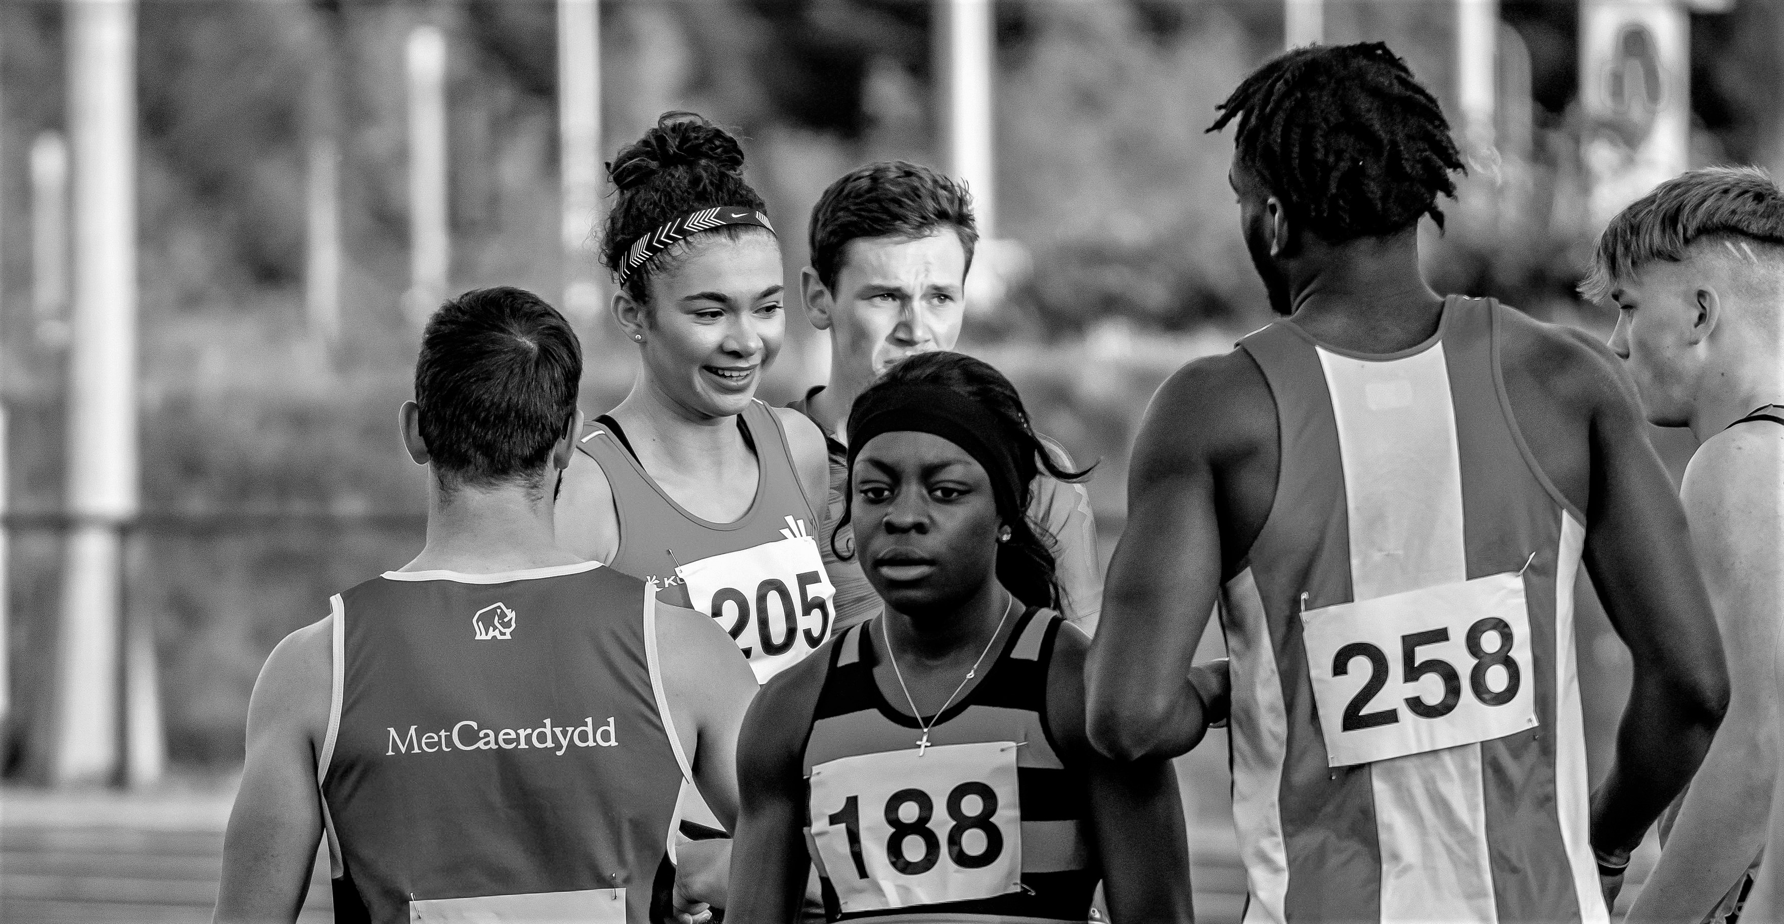
Embedding Equality, Diversity, & Inclusion

Slide 2
Strategic equality aims for athletics in Wales
Ensure Athletics is a safe and inclusive sport for all;
Target of 50% of clubs achieving InSport accreditation by 2026
Bring new people from all backgrounds in to our sport
Facilitate the removal of all barriers to participation.

Slide 3
The protected characteristics
age
disability
gender reassignment
marriage and civil partnership
pregnancy and maternity
race
religion or belief
sex
sexual orientation.

Slide 4
What do Equality, Diversity & Inclusion mean in terms of your club?
Opportunities – appeal to more people, gain new members
Respect - Lack of discrimination, everyone feels more included.
Equality Act 2010

Slide 5
Equality Act, section101: Members and associates
“(1)An association (A) must not discriminate against a person (B)—
(a)in the arrangements A makes for deciding who to admit to membership;
(b)as to the terms on which A is prepared to admit B to membership;
(c)by not accepting B's application for membership.”

Slide 6
Tools & Tips
Equality Impact Assessments – checklist for your internal club policies and activities
Toolkit – coming soon, collaborative working with UKA & other HCAFs
Talk to people, listen, and use data to help

Slide 7
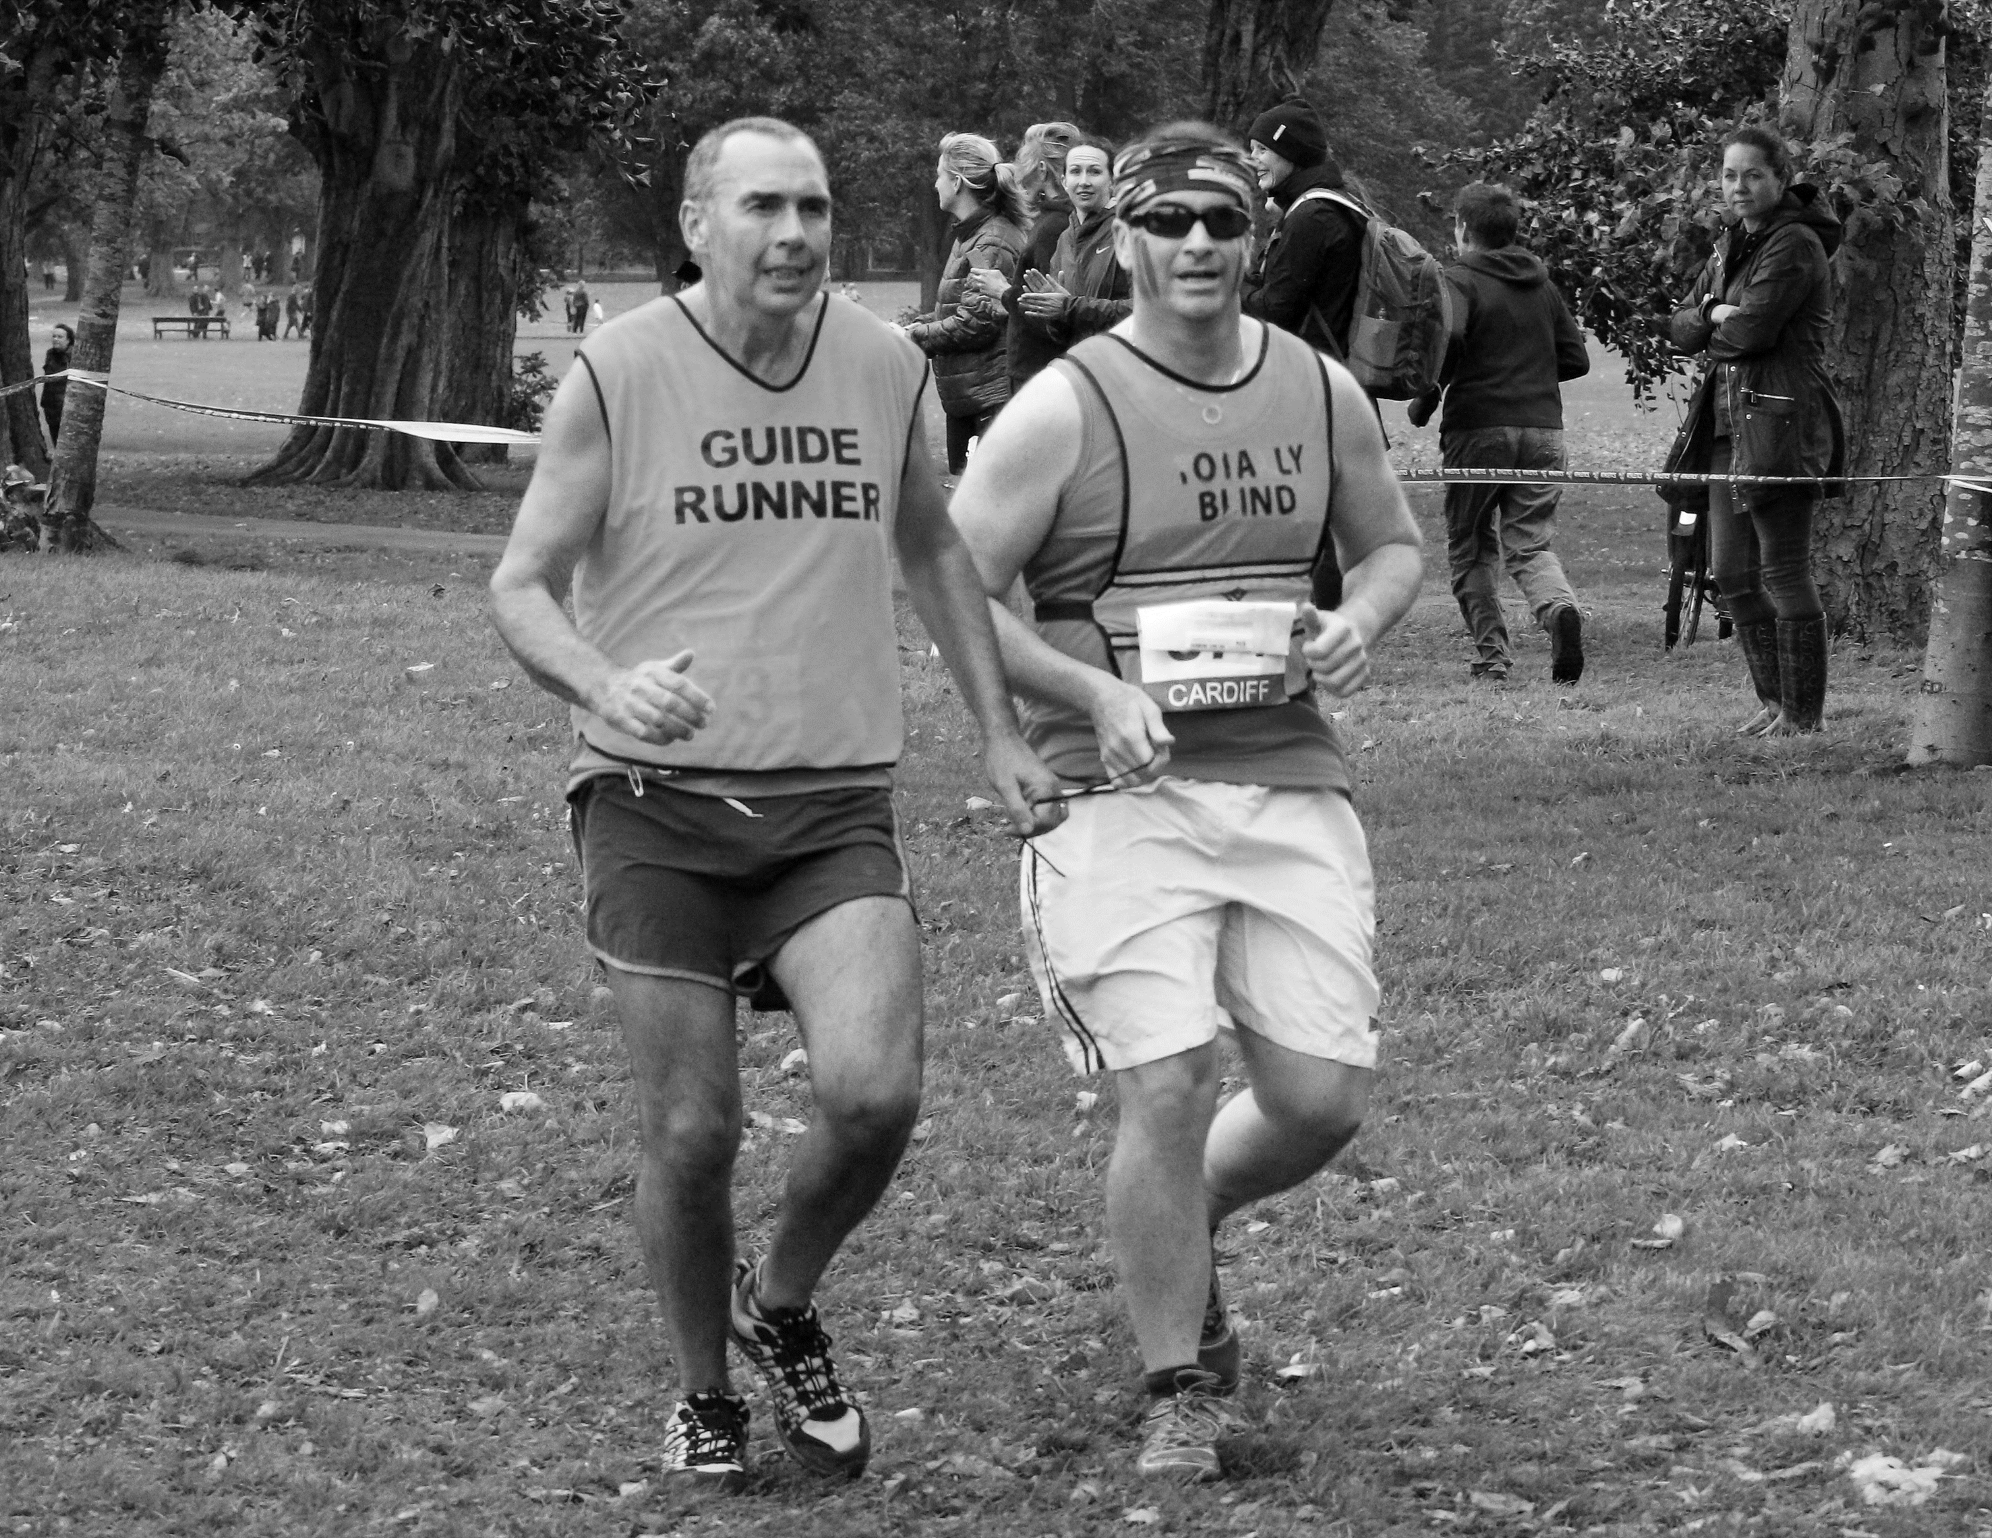
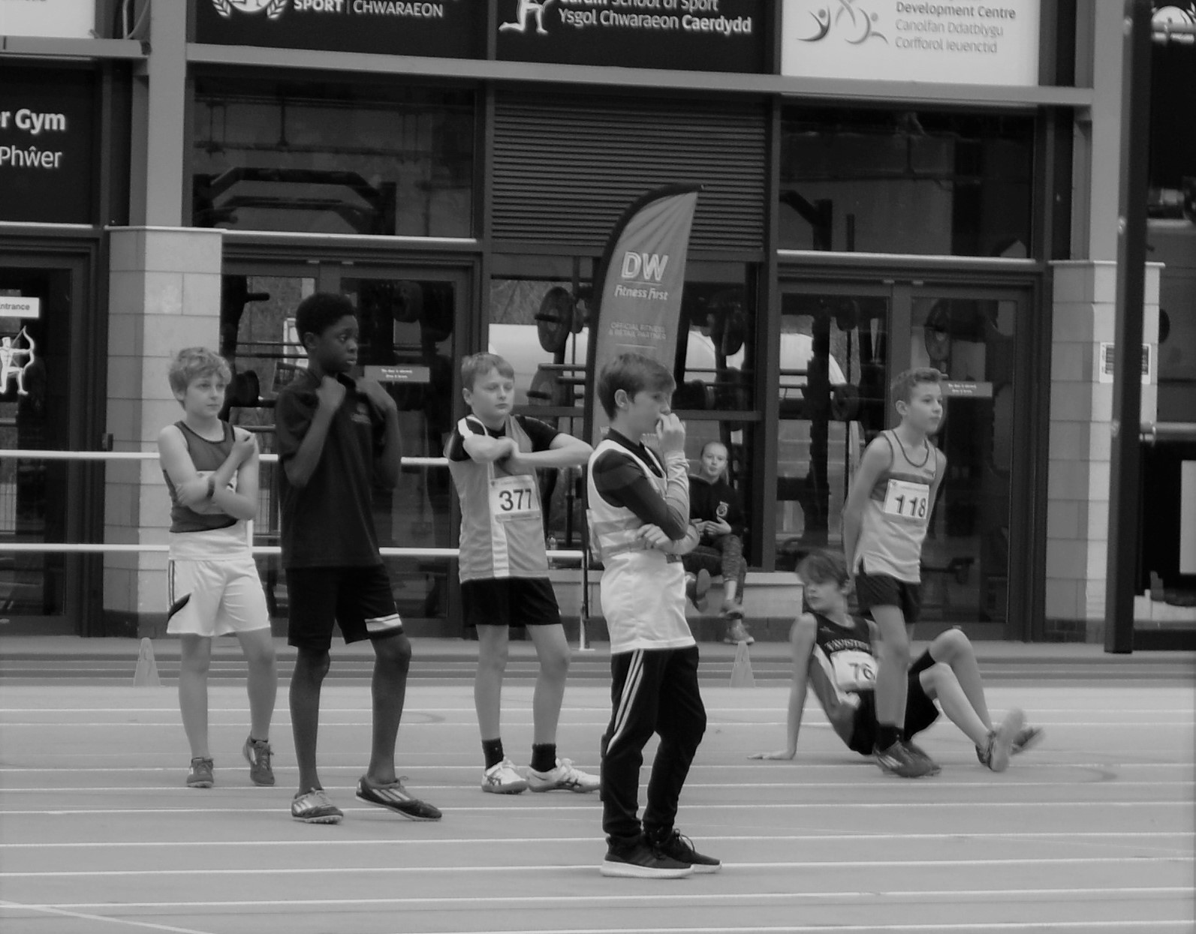
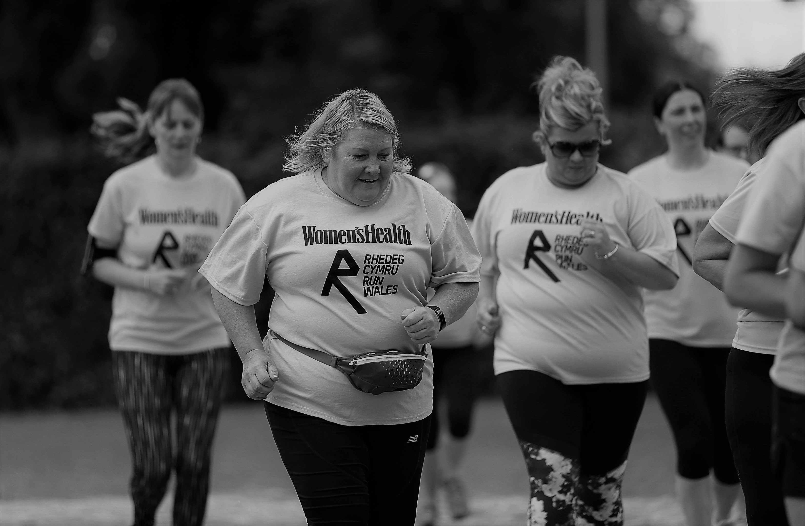
Thank you
Diolch

